Slide 1
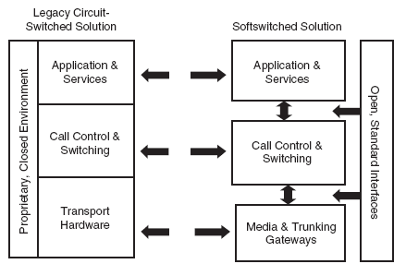
What is a Softswitch ?
A softswitch connect one phone line to another phone line, only by means of software architecture instead of Hardware.
Replace the classe 4/5 switch.
Widely used in IP Network
Build upon a standard and open architecture.
Notes:
A softswitch provide the same kind of actions as an electronic circuit switching devices. Nevertheless it is not build upon a fixed hardware configuration like the electronic cicruit switch, but on a simple computer running a software. This computer is as simple and as cheap as a server.
The softwitch tends to replace the former classe 4/5 switching devices. It is now widely used in VoIP network.
It is build upon a standard and open architecture. Thus, it is very simple and cheap to add extra functions to a softswitch.

Slide 2
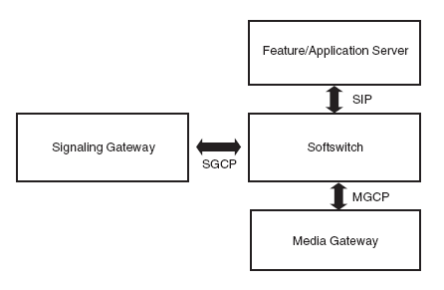
What is a Softswitch ?
The softswitch implements the Intelligence of the Network.
-Call forwarding
-Call redirection
-Last Call return
Easy to program and to modify with the Softswitch architecture.
Notes:
A softswitch implements the intelligence of a network. Like call forwarding, Call redirection, personnalized ring back tone and so on…
The function implemented by a softswitch is very easy to modified. That’s why globally the Softswitch provides more functionnalities than the previous electronic-based devices, and that for a cheaper price.

Slide 3
b) Simulation
Two kinds of simulation
Software: we build a model of the Softswitch and we simulate the call processing on a computer and we collect the data.
Materials: more realistic, we plug different “box” simulating the call processing on the softswitch server. Theses boxes are highly parameterisable and can output different call distributions, and functions.
Notes:
To Evaluate the performance of a softswitch system, two kind of simulation can be used.
-The first one, is to simulate the normal use of a softswitch on a computer, by programming. We need to know the differents reaction’s time of components. As we have studied it in project 1, I will not talk of it much more.
-The other kind of simulation, is material simulation.
Basically you input/plug some boxes on the softswitch input/output line. Theses boxes can simulate the normal functionnement of a call network. The will inject new call, according to the provided parameters, and stop it. This simulations, althoug more coslty, is one of the more precise.

Slide 4
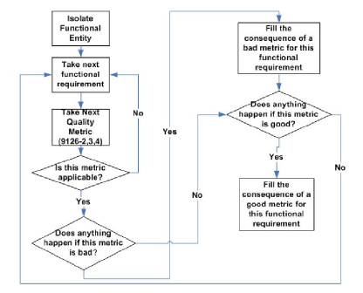
c) Functional analysis
The softswitch is divided up in small bricks based upon the functionnalitys they provide.
We model and simulate or test theses brick independantly.
We combine the results obtained for each bricks in order to get the softswitch performance.
Flow chart of the functional analysis
Notes:
The main idea of Functional analysis is to divide up the systems in different entities. These entitie’s performance should be easy to evaluate and the consequence of their performance well know.
We can thuses easyly analyses, where a bottleneck can occur for example.
At the end we can combine the results of theses differents bricks according to their function in the softswitch, and we can have an overall evaluation of the performance of a softswitch.

Slide 5
d)The performance depends on the Needs.
Each user do not have the same need (billing user != free user).
Each phase of a phone call depends on differents components/functions.
Each function need to give its best performance at a different moment.
Notes:
The performance of a softswitch can not be estimated if we don’t know for what particular needs the softswitch is designed. For example, while billing a softswitch don’t use the same function, as while handling traffic call. That’s why we need to know, when a particular function of a softswitch will be used to evaluate the performance of our softswitch.

Slide 6
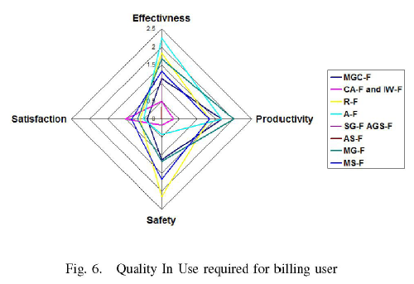
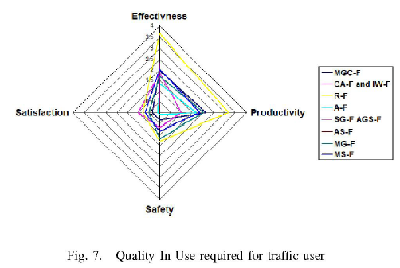
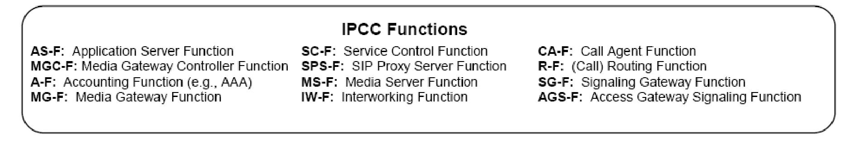
d)The performance depends on the Needs.
We need to ponderate the quality required of a function according to the phase of a call, or to an user.
Notes:
Thus we need to ponderate the differents criterions importance, according to the phase of our call. In this particular example, we can see than the Call Routing Function (the one that connect two phone line), is really important while a normal traffic user is occuring. But when it comes to bill the User, all the system must be safer and the Accounting Function, must be really efficient at that particular moment.
So In order to evaluate well a softswitch performance, we need to know which functions will be mostly used, and how importants are theses functions.

Slide 7
References:
Softswitch Multicriteria Analysis for Software Quality based on IPCC Reference Architecture (Ecole de Technologie Supérieure)
Softswitch . Franklin D. Orthman, Jr

